Slide 1
Louisiana Commission for the Deaf
Program Report
Jana Broussard
Acting Executive Director
Jazmyne Lemar
Interpreter Policy and Programming Manager
May 29, 2026

Slide 2
Interpreter Registration Timeline

Slide 3
Interpreter Registration Requirements
Registration requirements are in effect as of May 20, 2026. This is the date the final interpreter minimum standards and registration requirements were published in the Louisiana Register and classified in the Louisiana Administrative Code.

Slide 4
Interpreter Registration Requirements
Beginning May 20, these requirements apply to all sign language interpreters working in general community settings, including health care, conferences, workplaces, vocational rehabilitation, and postsecondary environments.
The requirements also apply to all sign language interpreters working in PreK–12 educational settings under the Louisiana Department of Education.

Slide 5
Interpreter Registration Requirements
Requirements for interpreters working in court and legal settings – including courtrooms, law enforcement interactions, depositions, and attorney-client meetings – are expected to be issued in the fall of 2026.
Minimum standards for Deaf Interpreters (individuals who are deaf or hard of hearing and provide interpreting or language support across signed languages or modalities) are also expected in the fall of 2026.

Slide 6
Interpreter Registration
Interpreters working in general community and PreK–12 educational settings are encouraged to begin registering by July 1 to be sure registration is done on time.
Interpreters in court/legal settings should keep their current registration with the Louisiana Supreme Court Office of Language Access and register as generalists with the Louisiana Commission for the Deaf until court-specific requirements are issued.

Slide 7
Interpreter Registration
Deaf interpreters will be eligible to register once new standards are published in the fall of 2026. In the meantime, they are encouraged to create a profile in the Louisiana Interpreter Registry beginning July 1.

Slide 8
Interpreter Registration
These rules apply to any person performing sign language interpreting services or otherwise helping with communication for d/Deaf, DeafBlind, or hard of hearing individuals, regardless of job title (e.g., interpreter, paraprofessional, aide, contractor). This includes full-time, part-time, and as-needed workers.
The rules do not apply to people providing direct instruction in sign language (such as teachers of the Deaf), interpreters providing services without payment, or those serving in religious settings.

Slide 9
Interpreter Registration
Registration requirements will be enforced starting January 1, 2027. No penalties will apply before that date.

Slide 10
Direct Services Update

Slide 11
Regional Support Centers
Beginning July 2026, regional support centers across the state will provide client or family assessments to determine which of the following are needed:
    Services (telecommunications, hearing aids)
    Support (information, training, resources)
    Advocacy (guidance, education, best practices, ADA)
    Referral (other state programs or local resources)

Slide 12
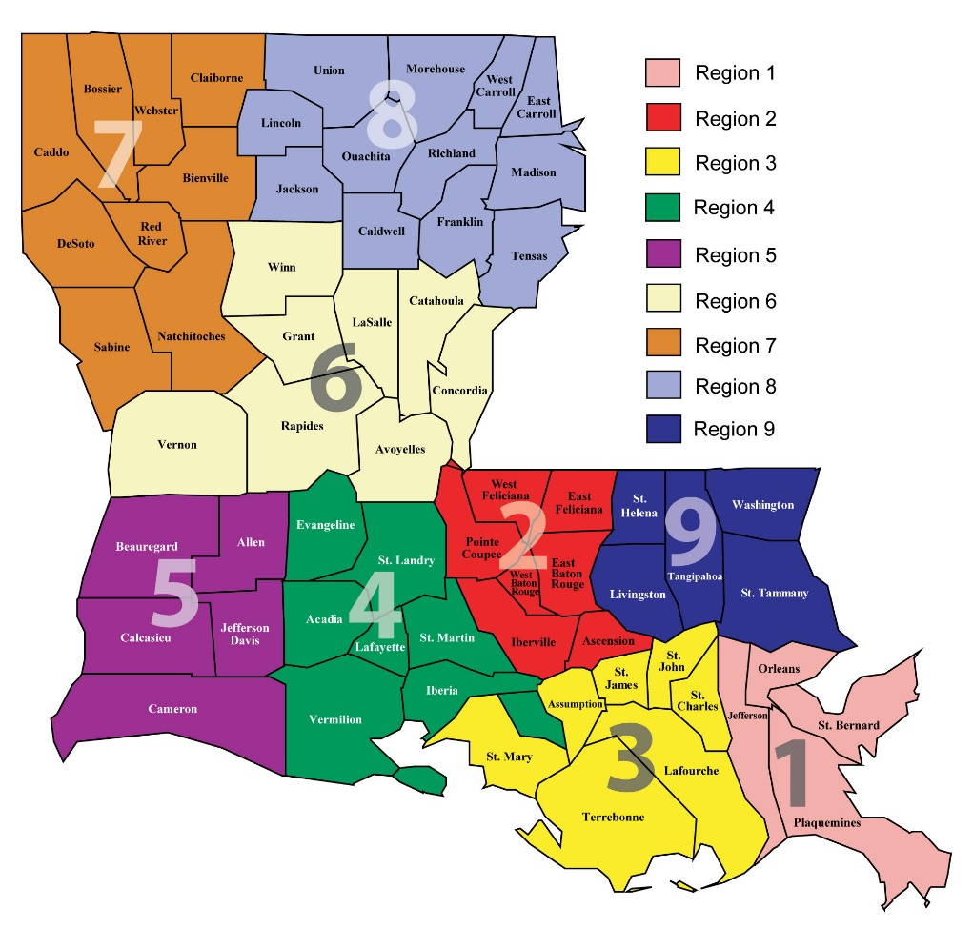
Regional Support Centers
Regions 1 and 9: Lighthouse Louisiana
Regions 2 and 3: Deaf Focus
Region 4: Affiliated Blind of Louisiana
Region 5: South Louisiana Independent Living Center
Regions 6, 7, 8: Deaf Action Center Shreveport

Slide 13
Communication Access Services
Beginning July 2026, communication access service providers will provide:
Sign language interpreting or communication access real-time captioning
Driver’s education access
Training and education for community and service providers
Support (information, training, resources)
Advocacy (guidance, best practices, ADA)
Referral (other state programs or local resources)

Slide 14

Communication Access Services
Regions 1, 2, 3, 4, 5, and 9: Deaf Focus
Regions 6, 7, and 8: Deaf Action Center Shreveport

Slide 15
Interpreter Mentorship Program Changes
The Statewide Interpreter Mentorship Program will be moved from the Louisiana Commission for the Deaf program office to the Louisiana Association of the Deaf dba Deaf Focus
Deaf Focus will be responsible for implementing Louisiana Commission for the Deaf’s statewide mentorship program to support interpreter workforce development
Program will move to Deaf Focus beginning December 2026
The Commission will continue to provide some mentoring services from July through November

Slide 16
Support Service Provider Program Contract
The support service provider program contract was awarded to Affiliated Blind of Louisiana Training Center through a request for proposal process
The support service provider program will continue as previously administered by Affiliated Blind of Louisiana
Funding for the Affiliated Blind of Louisiana program remains the same as the last several years

Slide 17
Support Service Provider Program Contract
Louisiana Commission for the Deaf is working closely with Affiliated Blind of Louisiana and third party consultants to review current policies, procedures, and opportunities
Louisiana Commission for the Deaf and Affiliated Blind of Louisiana held a policy review on May 15, including a Q&A with the DeafBlind community
Interviews were conducted privately with DeafBlind clients through third party consultants – a report with recommendations will be provided in June 2026

Slide 18
Financial Assistance
Program Proposal
Jazmyne Lemar
May 29, 2026

Slide 19
Financial Assistance Program Purpose
Improve recruitment and retention of interpreters across the state
Reduce costs to help interpreters meet the state’s minimum qualifications
Expand access to certification and testing opportunities for the interpreting workforce
Support interpreter training and higher education opportunities
Promote communication access for d/Deaf, DeafBlind, and hard of hearing individuals across Louisiana

Slide 20
Financial Assistance Goal
Help grow the number of sign language interpreters in Louisiana
Support interpreters in their professional development and those pursuing higher education opportunities
Help interpreters meet the state’s minimum qualification requirements for registration
Build a sustainable, qualified interpreting workforce throughout Louisiana

Slide 21
Why is This Being Proposed?
Interpreters often face financial barriers related to certification, testing, and higher education
While some school districts may provide some financial assistance for testing and higher education, Louisiana Commission for the Deaf looks to provide additional funding as needed
Legal mandate to promote statewide accessibility and service quality

Slide 22
Who Could Qualify?
Criteria to be established. Eligibility may include:
Interpreters without any verifiable credentialing or higher education
Interpreters within a specific financial threshold
Interpreters with limited access to resources, i.e. rural communities

Slide 23
Types of Financial Assistance
Testing Exams
  Center for Assessment of Sign Language Interpretation Exams
  Board for Evaluation of Interpreters Exams
  Educational Interpreter Performance Assessments
  Sign Language Proficiency Interviews
College tuition reimbursement
Certified Deaf Interpreter Training (40-hour training)
Note: Louisiana Commission for the Deaf will continue supporting participants regardless of exam outcomes

Slide 24
Implementation Plan
Phase One – Initial Request
Secure funding concept
Phase Two – Research and Identification
Gather constituent feedback and board input
Determine best practices
Create a budget

Slide 25
Implementation Plan
Phase Three – Development
Establish criteria
Define application process
Develop policy and procedures
Phase Four – Implementation
Program implementation to be determined

Slide 26
Operations Quarterly Report
Jana Broussard
May 29, 2026

Slide 27

Operations Quarterly Report
Quarterly presentation includes:
  Revenues from treasury
  Expenditure report

Slide 28
Revenue Last Seven Years
 |  | FY20 | FY21 | FY22 | FY23 | FY24 | FY25 | Current FY26
REVENUES |  | $3,417,203.69 | $3,454,649.73 | $3,358,701.53 | $3,698,106.48 | $3,603,683.93 | $3,639,686.02 | $3,150,910.18
EXPENDITURES |  | $1,944,325.00 | $2,716,136.00 | $2,660,963.16 | $3,881,298.32 | $3,228,339.09 | $3,270,915.75 | $2,857,227.14
BUDGETED AMOUNT |  | $2,716,136.00 | $2,716,136.00 | $2,716,136.00 | $5,956,979.00 | $3,733,299.00 | $3,942,612.00 | $4,206,606.80
FUND ADJUSTMENT |  | $0.00 | $0.00 | $0.00 | $0.00 | $0.00 | $0.00 | $0.00
INTEREST |  | $44,742.00 | $1,489.00 | $6,080.00 | $12,596.00 | $13,211.00 | $117,239.00 | $111,208.00
ACCUMULATIVE YEAR-END BALANCE |  | $4,423,991.17 | $5,163,993.90 | $5,867,812.27 | $5,697,221.91 | $6,085,777.78 | $6,571,787.05 | $6,979,678.09
July 1, 2025-
May 26, 2026

Slide 29
Current Expenditures
State Fiscal Year 2026
BUDGET TYPE | EXPENDITURE CATEGORY | EXPENDITURE DESCRIPTION | BUDGETED AMOUNT | ACTUAL EXPENSES | VARIANCE
PERSONAL SERVICES | SALARIES | 2 civil service positions | $ 300,000.00 | $ 178,380.82 | $ 121,619.18
PERSONAL SERVICES | OTHER COMPENSATION | WAE- as needed | $ 3,000.00 | $ 1,464.40 | $ 1,535.60
PERSONAL SERVICES | RELATED BENEFITS | Insurance, retirement, etc for 2 civil service | $ 60,000.00 | $ 87,347.74 | $ (27,347.74)
TRAVEL AND TRAINING | TRAVEL | 2 Civil Service Travel | $ 15,000.00 | $ 67.97 | $ 14,932.03
OPERATING SERVICES | OPERATING SERVICES | Includes equipment, utilities, phone, licenses, etc | $ 60,000.00 | $ 33,235.50 | $ 26,764.50
SUPPLIES | SUPPLIES | Office supplies, maintenance, etc | $ 3,000.00 | $ 194.44 | $ 2,805.56
PROFESSIONAL SERVICES | PROFESSIONAL SERVICES | may include staff, consultant, personal, or social service contracts | $ 3,753,806.80 | $ 2,560,120.21 | $ 1,193,686.59
OTHER CHARGES | OTHER CHARGES | Defined specific- may include adminstrative fees |  | $ 91,343.98 | $ (91,343.98)
INTERAGENCY TRANSFERS (IAT) EXPENSES | IAT EXPENSE | Contracts between a political subdivision (local or federal). Ex OTS | $ 11,800.00 | $ 14,105.72 | $ (2,305.72)
TOTAL PROGRAM EXPENSES |  |  | $ 4,206,606.80 | $2,966,260.78 | $ 1,240,346.02

Slide 30
Current Expenditures
Professional Services Breakdown
Contract | EXPENDITURE DESCRIPTION | BUDGETED AMOUNT | ACTUAL EXPENSES | VARIANCE | Note
RSC 1,2,3,9 | HAP, TAP, TERP | $ 133,374.95 | $ 96,274.01 | $ 37,100.94 | Community based services
RSC Laf Parish | HAP, TAP, TERP | $ 47,000.00 | $ 28,975.60 | $ 18,024.40 | Community based services
RSC 4, 5 | HAP, TAP, TERP | $ 79,900.00 | $ 62,720.00 | $ 17,180.00 | Community based services
RSC 6,7,8 | HAP, TAP, TERP | $ 147,000.00 | $ 97,013.87 | $ 49,986.13 | Community based services
SSP Program | Services for DeafBlind | $ 600,000.00 | $ 408,933.79 | $ 191,066.21 | Community based services
Hearing Aids | Aid Equipment- various vendors | $ 1,982,333.33 | $ 1,418,354.26 | $ 563,979.07 | Community based services
Staffing Contract | Program Manager; Admin Coordinator, Comms Officer, Ex Assistant, Outreach/Training Coordinator, Staff Interpreter x2 | $ 710,573.47 | $ 517,722.25 | $ 192,851.22 | Mentorship Program Included: Total Expenditures = $77, 317.44
Community Parterships/Training | Community trainings and interpreter professional development | $ 30,000.00 | $ 11,837.50 | $ 18,162.50 | LAD, LRID, and NODBA
Title II Accomodations | Communication Access- ADA | $ 45,000.00 | $ 75,523.83 | $ (30,523.83) | LCD, BFH, OPH and LDH
 |  | $ 3,775,181.75 | $ 2,717,355.11 | $ 1,057,826.64

Slide 31
Thank you

